Slide 1
Dane’s Sprint 5 Goals
Enable basic movement around the board
Planning to invest 8 hours toward this goals

Slide 2
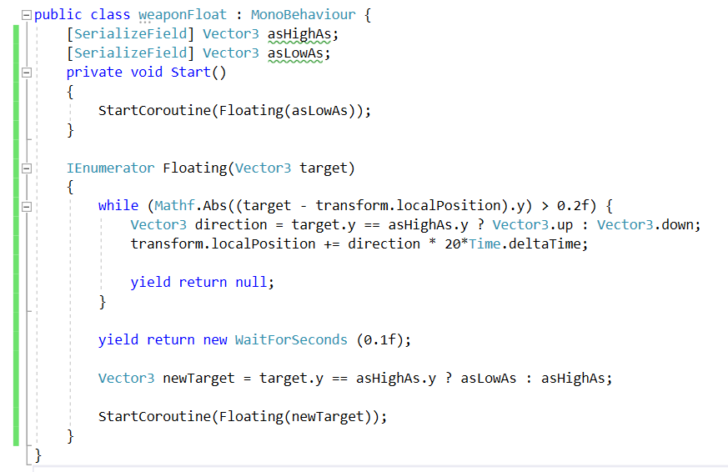
Dane’s Sprint 5 Accomplishments
Learned about IEnumerators with the “yield” command

Slide 3
Dane’s Sprint 5 Accomplishments
*Completed 11 hours of work to achieve these goals
Integrated Billy’s board with my code
Used Billy’s models and co-routines to make a weapon float above the board
Spawned pieces on the board (and they aren’t just cubes anymore folks!)
After 2 sprints, can finally move the pieces around the board

